Slide 1


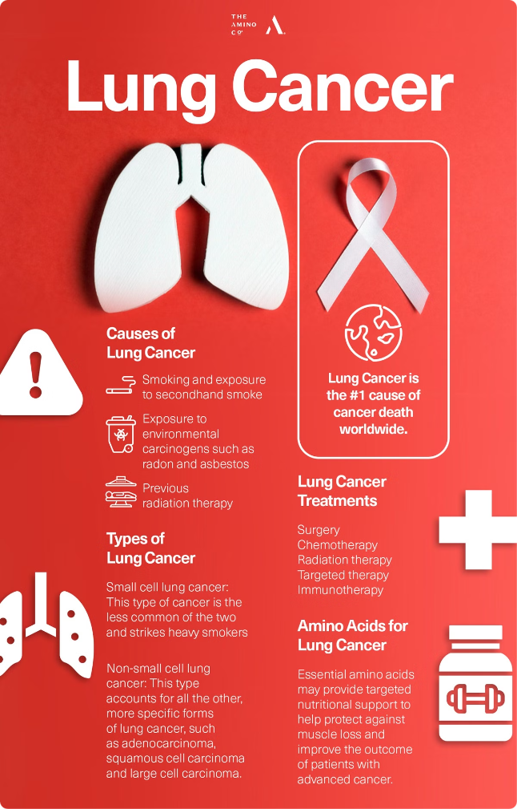
Lung Cancer Detection: Machine Learning and Deep Learning Revolution
Revolutionizing lung cancer detection.

Slide 2

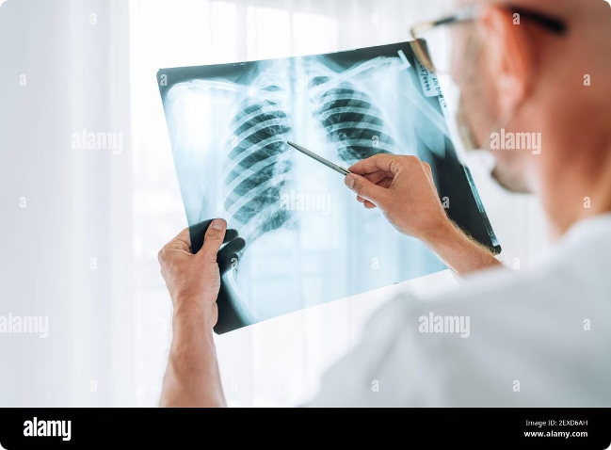
The Challenge: Early Lung Cancer Detection
Early detection is crucial for effective treatment.
1
Limited Accuracy
2
Late Detection
Traditional screening methods are often inaccurate.
Most cases are diagnosed at advanced stages.
3
High Costs
4
Patient Burden
Screening procedures are expensive and time-consuming.
Multiple tests and procedures increase patient stress.

Slide 3
Comprehensive System: Machine Learning Pipeline
A systematic approach for detecting lung cancer.
1
Data Collection
Gathering and preparing relevant data sets.
2
Feature Extraction
Identifying patterns and features within the data.
3
Model Training
Developing and optimizing machine learning models.
4
Prediction
Utilizing trained models to predict lung cancer risk.
5
Evaluation
Assessing the accuracy and performance of the models.

Slide 4


Data-Driven Insights: Feature Engineering
Extracting valuable information from diverse sources.
Medical Imaging
CT scans, X-rays, PET scans
Patient Data
Age, gender, smoking history, family history
Biomarkers
Genetic markers, blood tests

Slide 5

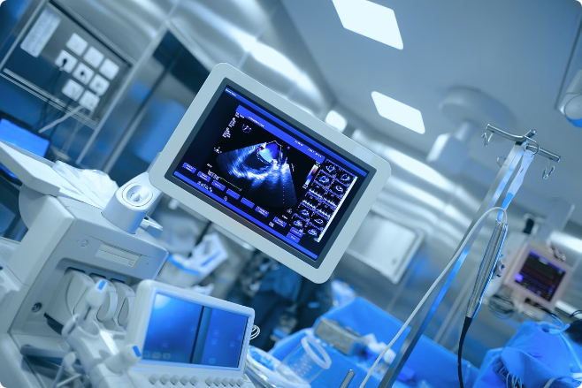



Existing Solutions: Limitations and Opportunities
Existing methods have limitations that machine learning can address.
Traditional Screening
Limited sensitivity and specificity.
Computer-Aided Diagnosis
Focuses on specific features, not overall risk.
Machine Learning
Holistic analysis for improved accuracy and efficiency.

Slide 6

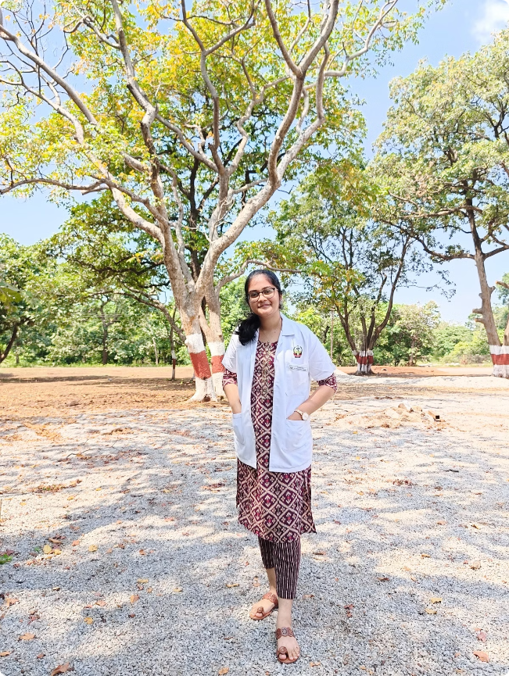
Client-Driven Integration: Seamless Workflow
Integrating with existing clinical workflows.
Name:
PROFESSION:
Dr. Deepika Ramireddy
Intern as a pulmonologist.
AGE:
Swasa clinics.
27
Decision Support
Providing valuable insights for informed decision-making.

Slide 7
Transformative Outcomes: Improved Diagnosis
Machine learning offers a more accurate and efficient approach.
Increased Accuracy
Reduced False Positives
Streamlined Workflows
Enhanced diagnostic capabilities for early detection.
Faster and more efficient diagnosis for faster treatment.
Minimizing unnecessary procedures and patient anxiety.

Slide 8
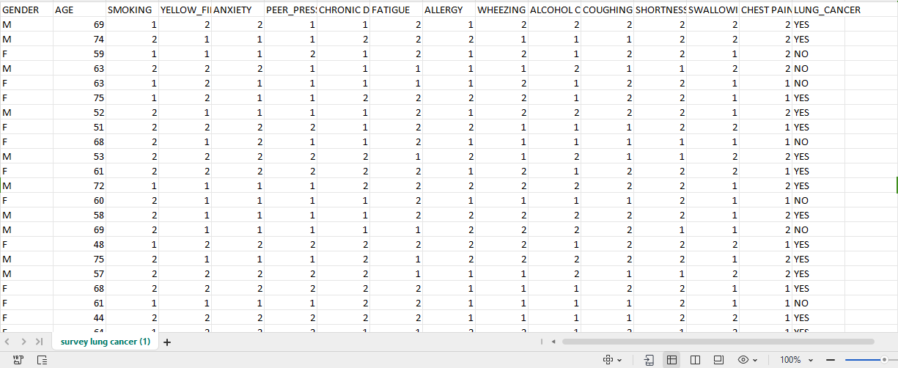
DataSet- Input as Text Data

Slide 9
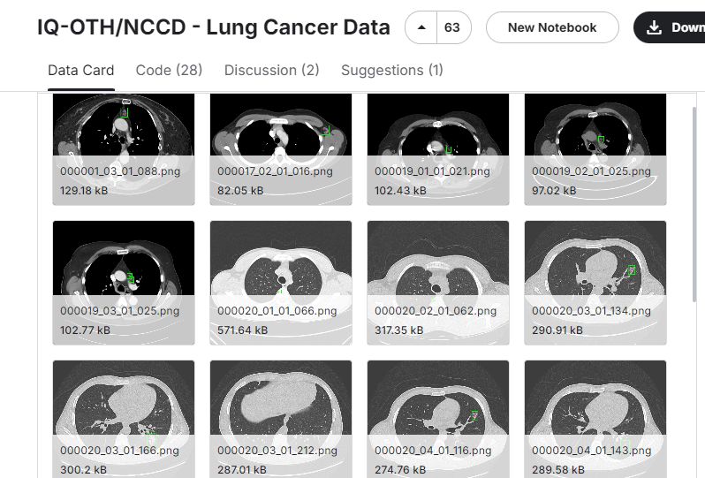
DataSet- Input as Images

Slide 10
Existing Systems
Lung Cancer Using CAD Approach
Silva et al. [15] proposed a CAD approach, as described in their publication, which was based on the U-Net and ResNet-34 architectures. The method was applied to four different cross-cohort datasets. To evaluate the performance of their approach, the authors utilized the dice similarity coefficient (DSC). The DSC is a commonly used metric in medical image segmentation tasks and measures the overlap between the predicted and ground truth segmentations, with a value ranging from 0 to 1. According to the findings reported by Silva et al. [15], the CAD approach achieved a mean DSC value exceeding 0.93 across the four different cross-cohort datasets. This suggests that the method performed well in accurately segmenting and delineating structures of interest in the medical images. The method was reviewed by two radiation experts who identified certain limitations, particularly in the case of consolidation. However, the developed system achieved an accuracy of over 99.3% and an F-score of 99.2%. The study employed four performance metrics to evaluate the disease. Additionally, the system was evaluated using two DL tools on three datasets.

Slide 11
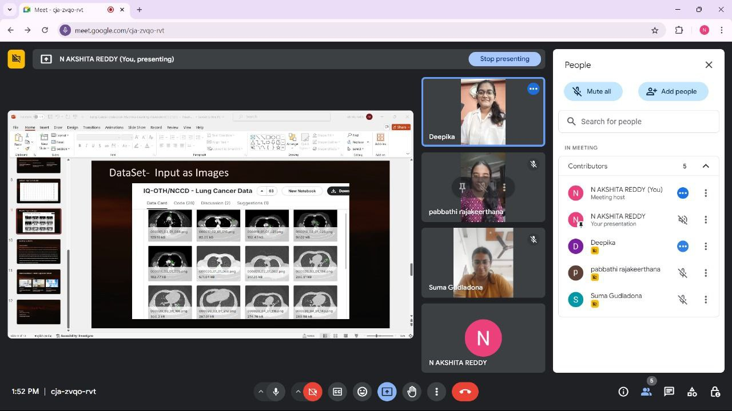
Picture With Client

Slide 12

Picture With Client

Slide 13
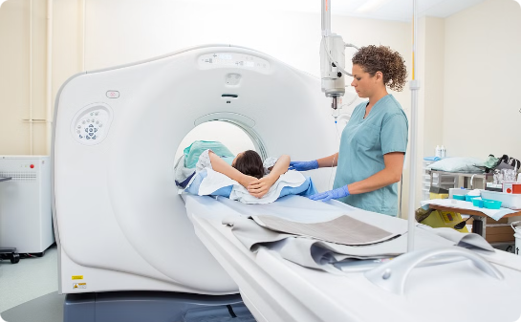
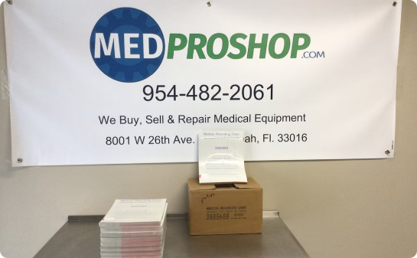

Data Foundation: Curated Lung Cancer Dataset
A robust and comprehensive dataset is essential.
Imaging Data
Patient Data
Biomarker Data
CT scans, X-rays, and other relevant images.
Demographic information, medical history, and clinical data.
Genetic markers, blood tests, and other biomarkers.

Slide 14
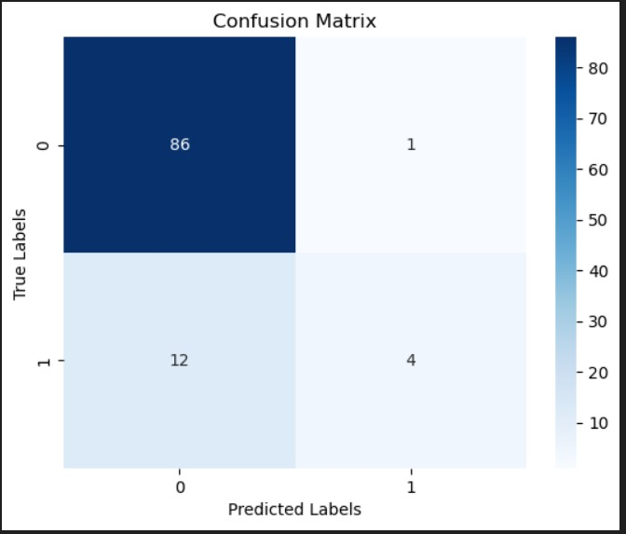
Confusion Matrix

Slide 15
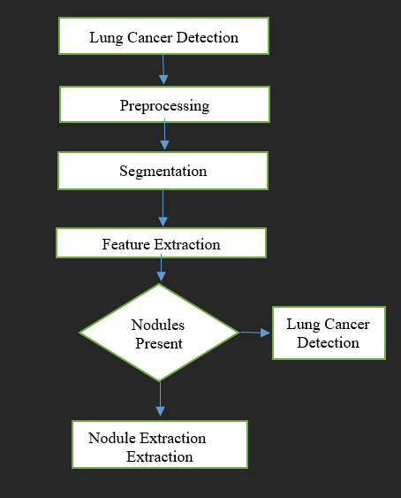
Flow Chart for Proposed System

Slide 16
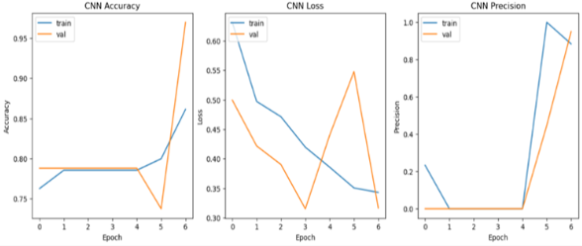
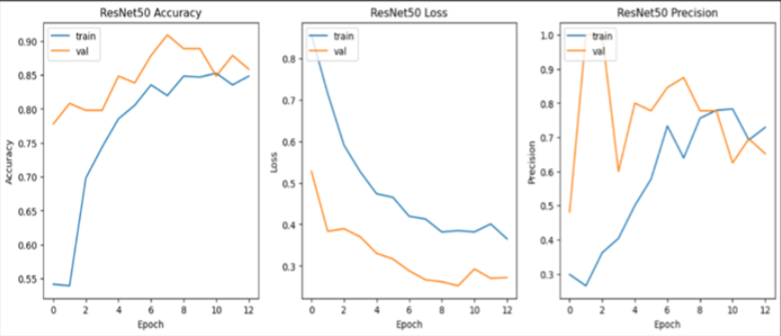
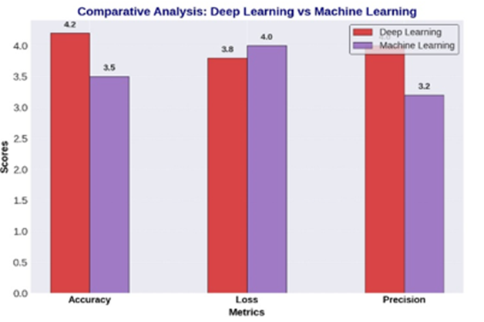
RESULTS

Slide 17
CONFERENCE:
ICRAIC2IT-25 (International Conference on “Recent Advancements in AI, Computational Intelligence, and Inclusive Technologies

Slide 18
Thank You!
Presented by:
N.AKSHITA REDDY(22`0030358)
G.SUMA(2210030029)
P.RAJA KEERTHANA(2210030240)

